Slide 1
The Analysis of Discrete-Event System in Autonomous Package Delivery using Legged Robot and Conveyor Belt
Final Report
ME6401
10.11.2020
Garen Haddeler
A0208496U

Slide 2
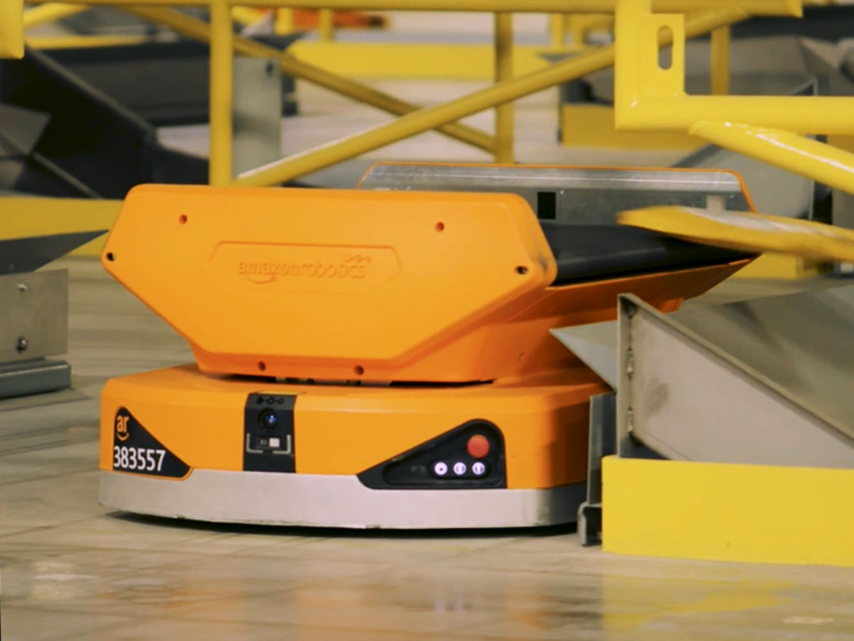
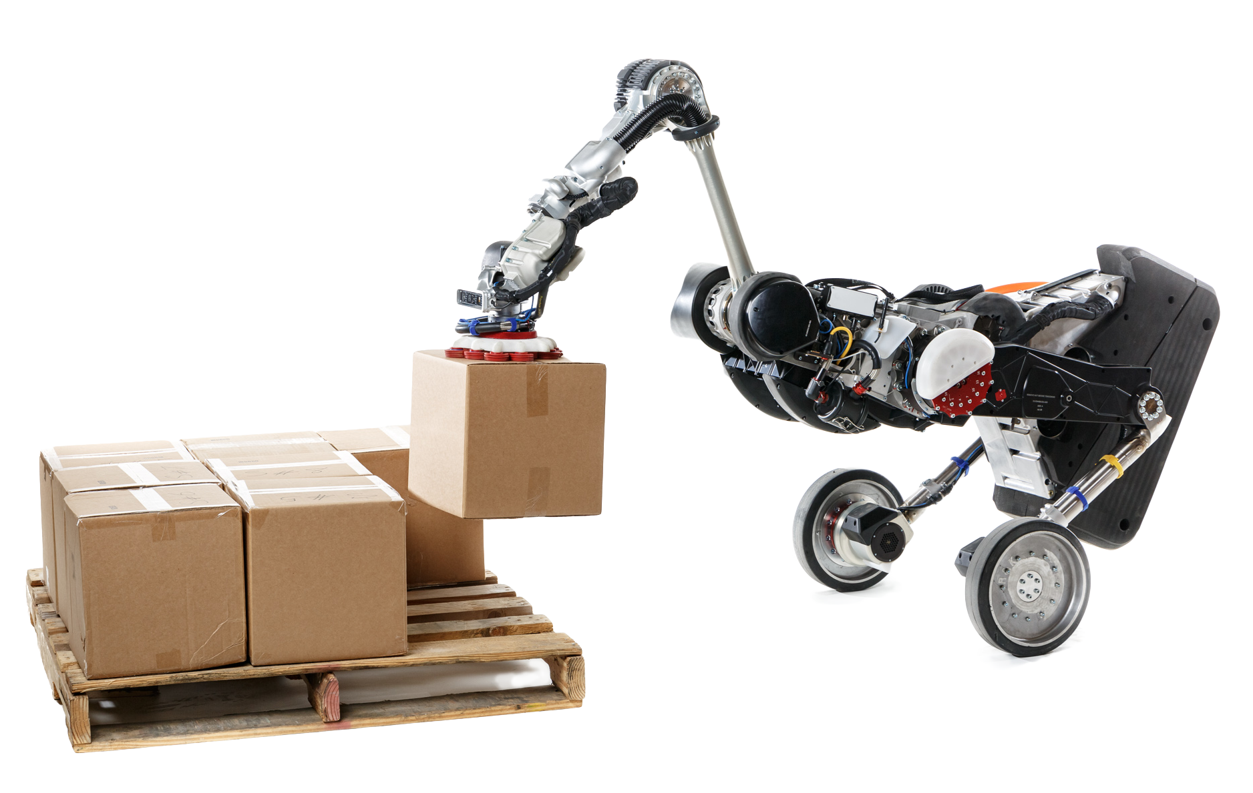
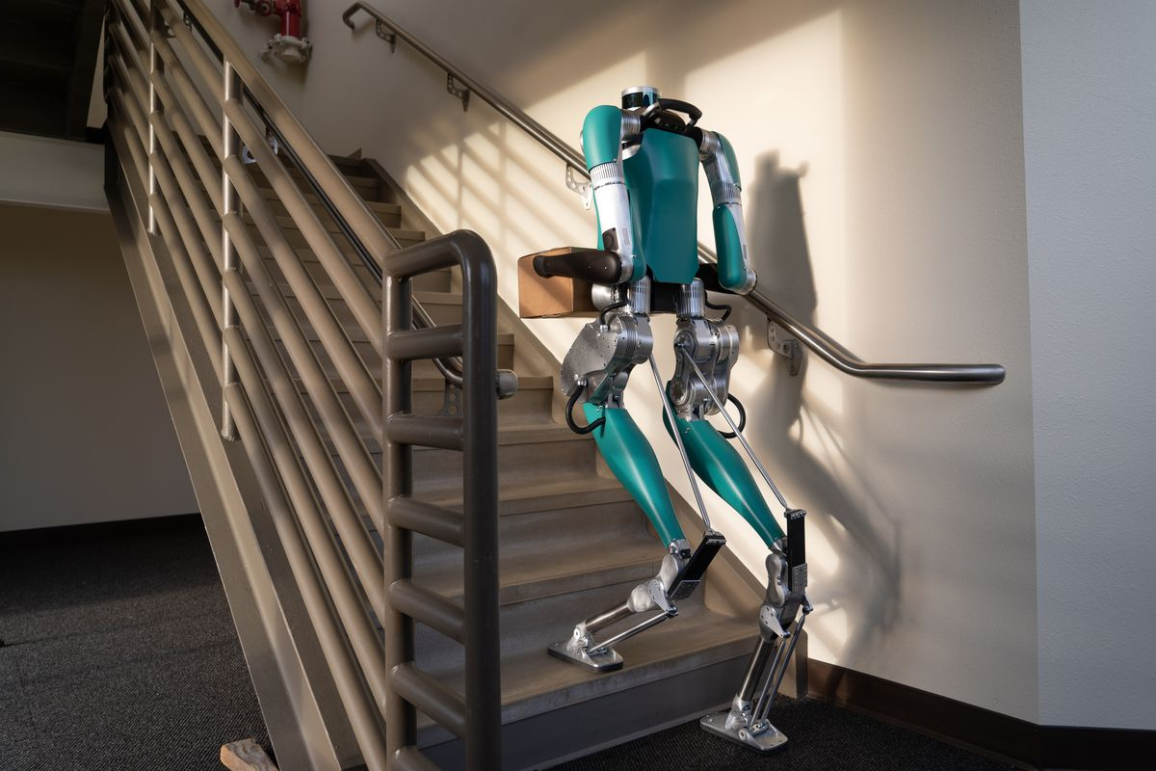
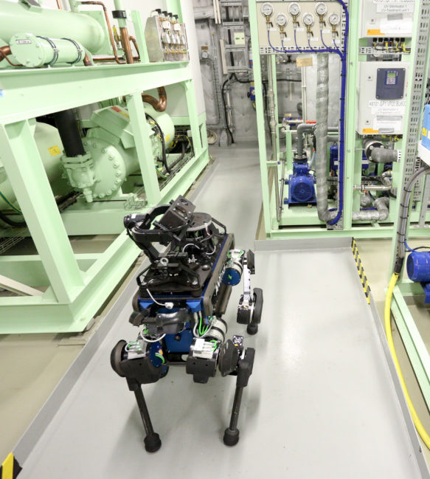
Autonomous Package Delivery: Motivation
Today’s robots are not fully capable of deliver packages in indoor and multi-floor environment
Systematic package delivery for uneven terrain
Amazon’s swarm robots for warehouse [1]
Navigating in indoor terrain, wheeled bipedal robot [2]
Bipedal humanoid robot for cargo delivery [3]
Quadrupedal robot for inspection [4]
[1] Pegasus Robot,Amazon Robotics
[2] HandleTM Boston Dynamics
[3] Digit, Agility Robotics & Ford
[4]Anymal, ANYBotics

Slide 3
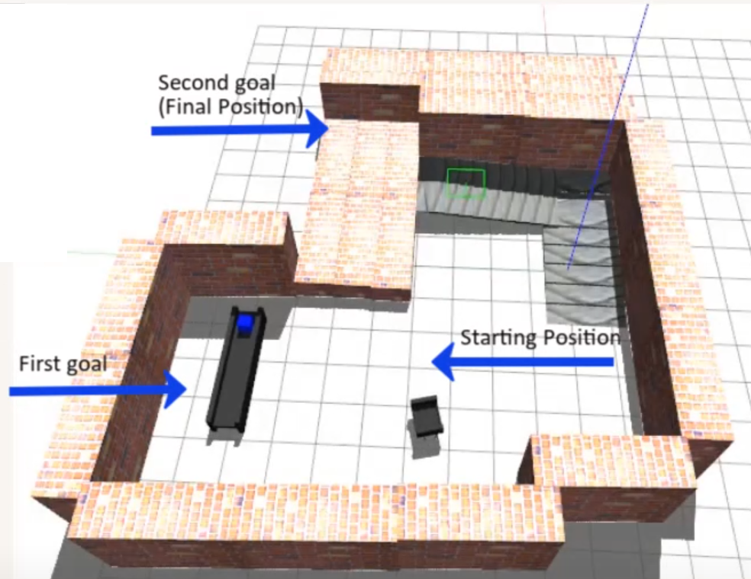
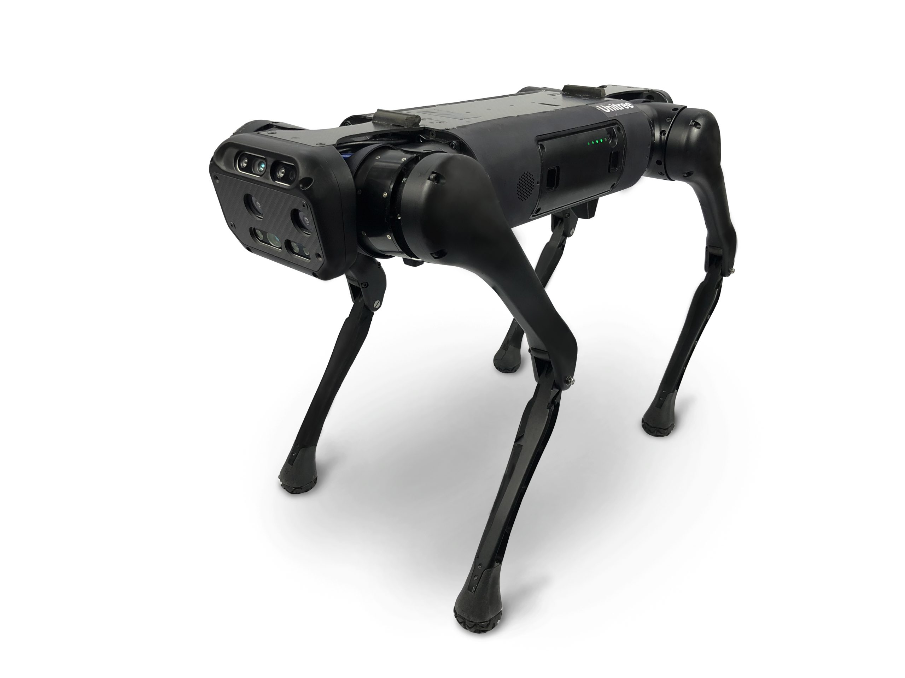
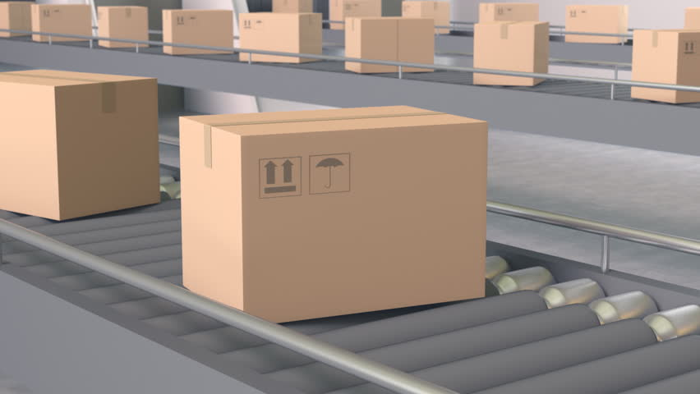
Autonomous Package Delivery: Overview
Objective:
Navigate multi-floor terrain and deliver package
using legged robot
Use Supervisory control of a Discrete Event System (DES)
to provide robot collaboration
Scenario :
Robot arrives in front of conveyor belt (First Goal)
Takes package from a conveyor belt
Delivers to desired goal position (Second Goal)
Multi-floor Terrain Environment
Quadrupedal Robot for delivering desired goals, Aliengo
Conveyor belt for moving packages

Slide 4
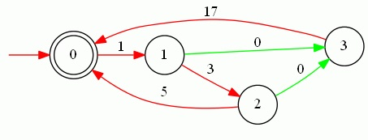
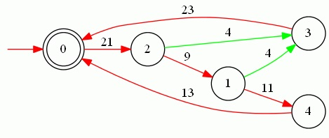
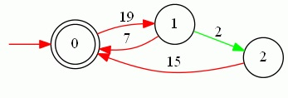
Automation and System Structure: Individual Machine
Machine-1 First Task Robot
Machine-2 Conveyor Belt
Machine-3 Second Task Robot
States | Events
Robot Idle 0 | First goal started 1
Walking 1 | First goal reached 3, Robot failed 0
Docking 2 | Docking finished 5, Robot failed 0
Fail 3 | Error flag 17
States | Events
Conveyor Idle 0 | Moving box 19
Working 1 | Stopping box 7, Box dropped 2
Fail 2 | Spawn box 15
States | Events
Robot Idle 0 | Box is on the robot 21
Walking 1 | Second goal reached 11, Robot failed 3
Stand up 2 | Second goal started 9, Robot failed 3
Fail 3 | Error flag 23
Success 4 | Success flag 13
Machines:
Delivery robot: First Task Quadrupedal robot (Machine 1)
Control conveyor belt (Machine 2)
Delivery robot: Second Task Quadrupedal robot (Machine 3)

Slide 5
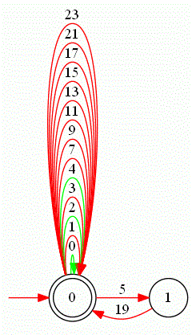
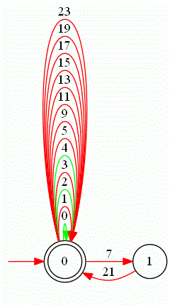
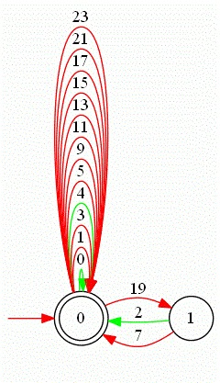
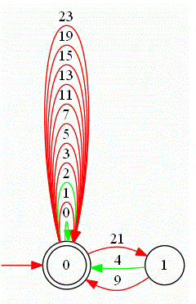
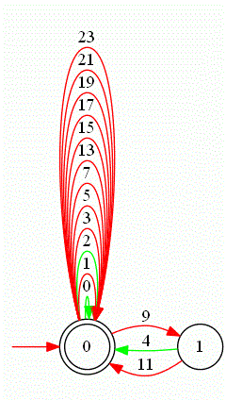
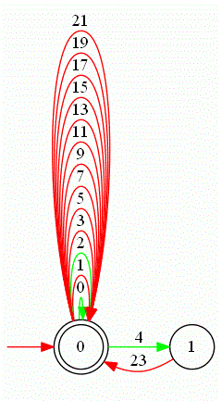
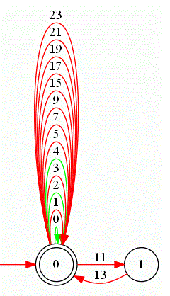
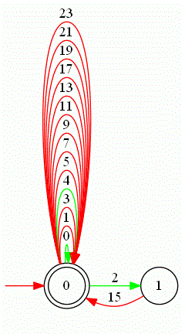
Automation and System Structure: Specifications
No. | Spec. Definitions
1 | After docking finished (5), moving box (19) event must start
2 | After moving box (19) finished, stopping box (7) event must start or as an uncontrollable event box can be dropped on floor (2)
3 | After stopping box (7) finished, box is on the robot (21) must start.
4 | After box is on the robot (21), second goal started (9) event must start or as an uncontrollable event robot can be failed (4)
5 | After second goal started (9), second goal reached (11) event must start or as an uncontrollable event robot can be failed (4).
6 | After second goal reached (11), success flag (13) event must start
7 | After uncontrollable event robot fails (0 and 4), error flag (23) event must start.
8 | After uncontrollable event box dropped (2), spawn box (15) event must start.
Spec-1 Spec-2 Spec-3 Spec-4
Spec-5 Spec-6 Spec-7 Spec-8

Slide 6
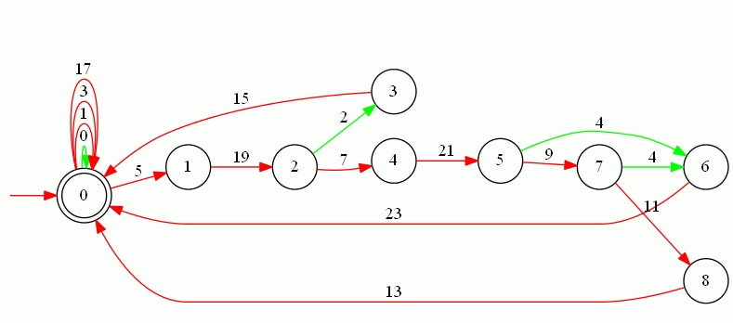
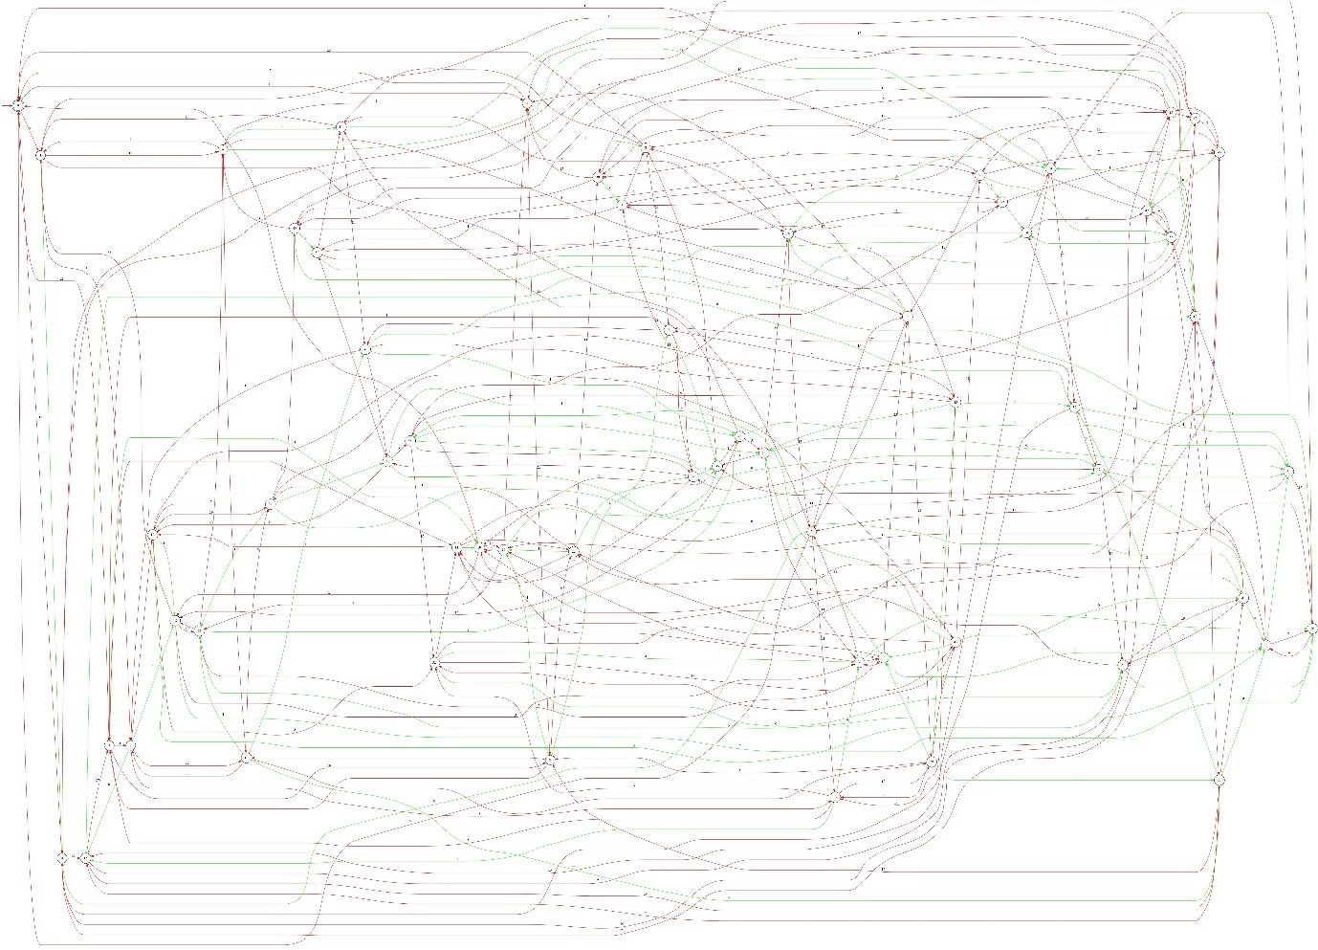
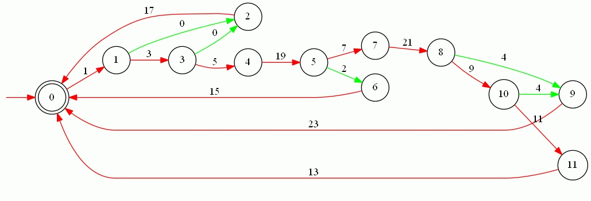
Automation and System Structure: Obtained DES model
Combined Specification for Supervisory Control
Free Behavior (60 states and 254 transitions)
Controlled Behavior using Supervisory Control (12 states and 17 transitions)

Slide 7
Automation and System Structure: Case Evaluation
Our Scenario:
First goal started 1
First goal reached 3
Docking finished 5,
Moving box 19
Stopping box 7
Box is on the robot 21
Second goal started 9
Second goal reached 11
Returns Idle state with Success flag 13
If robot is in Walking and Docking states and Robot failed with event 0, returns to Idle with Error flag 17
If conveyor is in Working state and conveyor failed with event 2, returns to Idle with spawn box 15
If robot is in Walking and Stand-up states Robot can be failed with event 4, returns to Idle with Error flag 23
Controlled Behavior using Supervisory Control, (Red) controllable, (Green) uncontrollable events

Slide 8
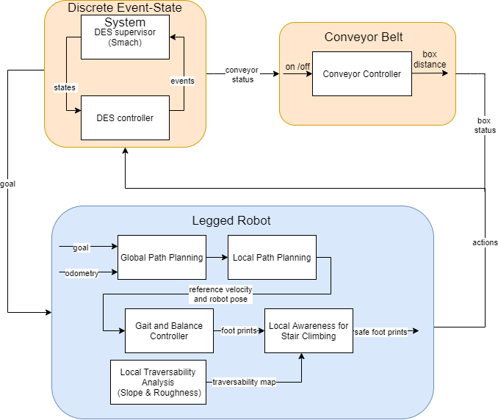
Experiment: Framework
Discrete Event-State executes events according to states
Conveyor Belt moves package to specific distance
Legged Robot autonomously navigates and delivers package to desired destinations

Slide 9
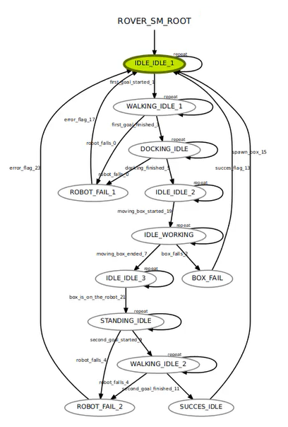
Experiment: Controlled Behavior DES Model
TCT Software
ROS-Smach (State machine)

Slide 10
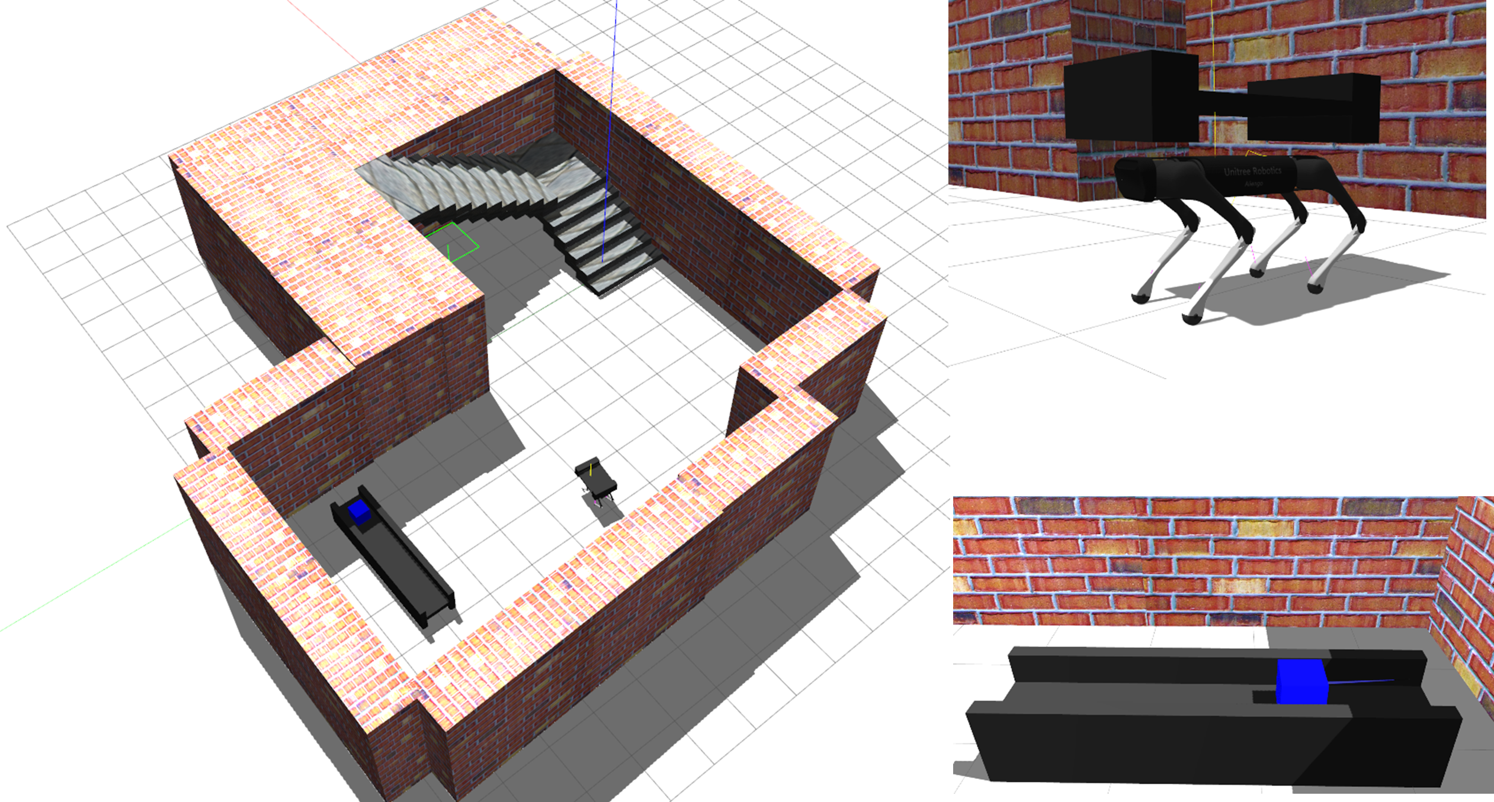
Experiment: Simulation Environment
Snapshots of Autonomous Package Delivery Scenario: (Left) Multi-floor environment, (Right-Up) Legged robot with carrier, (Right-Bottom) Conveyor belt with package

Slide 11
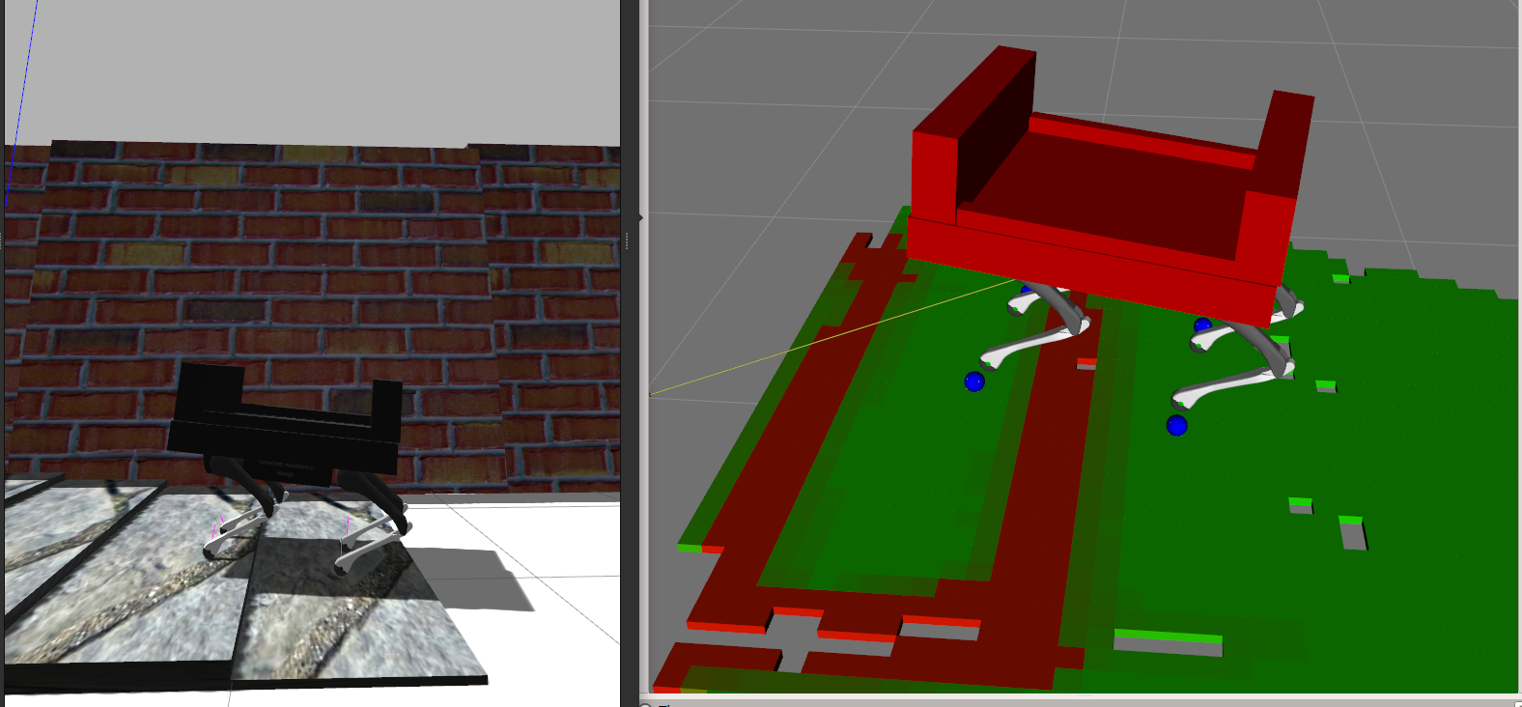
Experiment: Local Awareness while Climbing Stair
Local Awareness using Traversability Analysis: (Left) Simulation of Stair , (Right) Rviz visualization of sensors, red-green indicates untraversable and traversable respectively

Slide 12
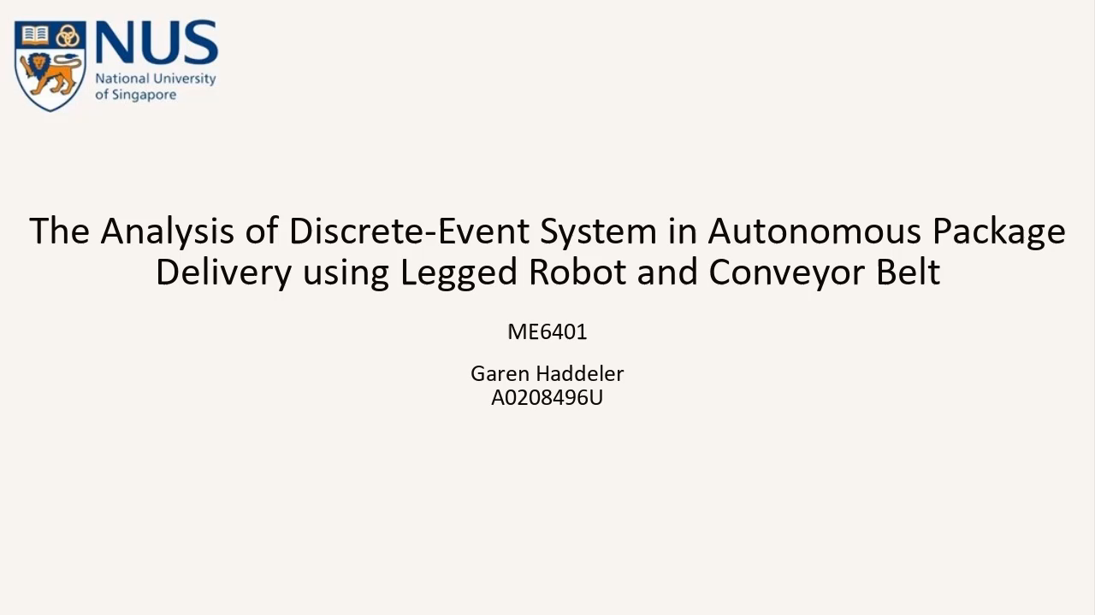
Experiment: Result

Slide 13
Conclusion
By applying Theory of Supervisory control of DES, we show collaboration of two individual robots to deliver goods in multi-floor environment
We obtained free behaviour, specifications and controlled behaviour
The controlled behaviour of DES is implemented and verified in real-life application

Slide 14
Thank you for listening

